Slide 1

Return the Glory
A look at what it takes to win.

Slide 2
Problem Statement
While US Soccer has been gaining ground, the failure of the USMNT to qualify for the World Cup is a setback.
US Soccer has an established presence with the USWNT having won 3 World Cup finals and 4 gold medals.
Providing an interactive tool to predict the outcome for a game would increase interest in the women’s World Cup and ultimately benefit US Soccer.

Slide 3
Project GOOOOOALS!
Analyze USWNT data
Create a working model
Create a tool to share the model

Slide 4
Source Data
Data for the US Women’s National Soccer Team was obtained through the WoSo Stats project, data collected by volunteers using a controlled spreadsheet and predefined criteria.
https://wosostats.wordpress.com/
Data from 2015-2017 games
She Believes Cup
Concacaf
2016 Olympics
International friendlies

Slide 5
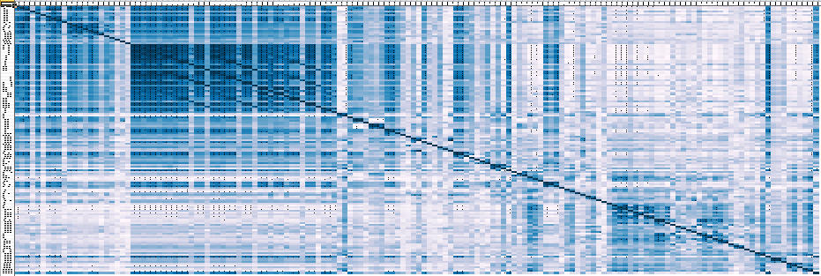

Starting Talent

Slide 6
Selecting the Players

Slide 7
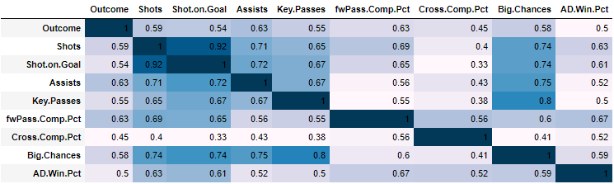
Diversify Talent (Check for Co-Variance)

Slide 8
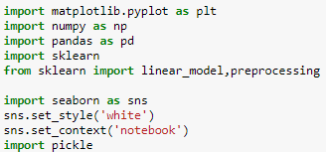
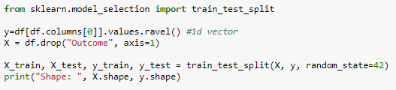
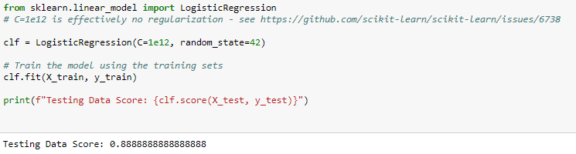
Model Check

Slide 9
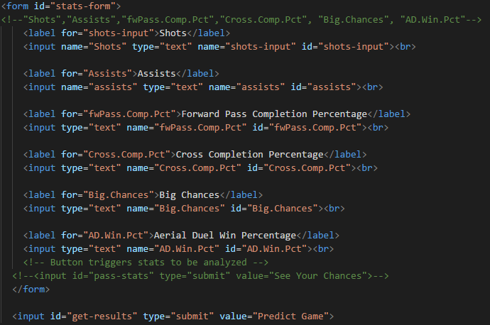
Code Check

Slide 10
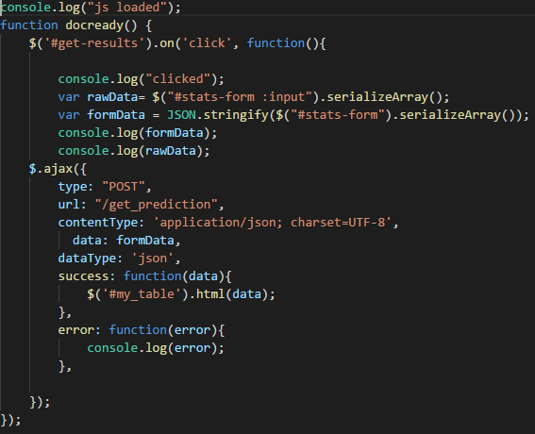
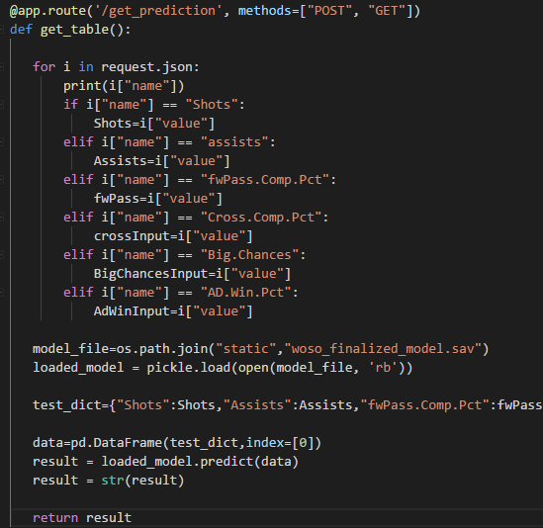
Code Check

Slide 11
Game Time

Slide 12
Team Challenges
Formatting the data (list of JSON) from the webpage form into a pandas dataframe for the model
Solution:
Manually assign the JSON output to variables
Create a dictionary
Convert to dataframe using first object in list

Slide 13
Next Season…
Create a form that would calculate percentages
Find more data on other national women’s teams
Analyze some USMNT games to see how they compare. Do they have the same key stats?

